Slide 1
University Library Database Project
Boosung Kim
Christian Gonzalez

Slide 2
TABLE OF CONTENTS
01
02
03
Brief Intro
Technical Details
System Overview
04
05
06
Demonstration
Conclusion
Key Findings & Insights
We’ll provide a brief introduction to our project
We’ll explain our DBMS choice and associated documents
We’ll explain key functionalities that our system offers
We’ll show you our work in action.
We’ll summarize our project and offer some concluding remarks
We’ll discuss the challenges we faced and how we overcame them

Slide 3

Introduction
Throughout the semester, we have learned about the various critical roles that database management systems (DBMS) have in the modern tech landscape. They provide a framework for data organization and storage, ensure data integrity and security, include data accessibility and retrieval, implement concurrency control and transaction management, and offer enhanced scalability and performance.

Slide 4
System Functionalities
Key Features
Target Users
The ability to search for books in the database after authentication.
Borrowers can generate borrow history reports that reveal all the books they are currently borrowing along with loans they’ve had in the past.
The ability to edit book information (such as author(s), title, date of publication, etc.).
The ability to generate reports on available and unavailable books.
The ability to mark books as available or unavailable.
Students: Search for books, borrow books, has a borrow history that can be viewed, and can be loaned a book for a week.
Professors: Search for books, borrow books, has a borrow history that can be viewed, can be loaned a book for two weeks.
Librarians: Can update book information, can update book checkout status, and they can generate reports on available books.

Slide 5
Technical Details
Database Design
Underlying DBMS is SQLite (familiar).

Slide 6
Technical Details
Database Design
Entity-Relationship Model
Underlying DBMS is SQLite (familiar).
Guide the structure of our database.

Slide 7
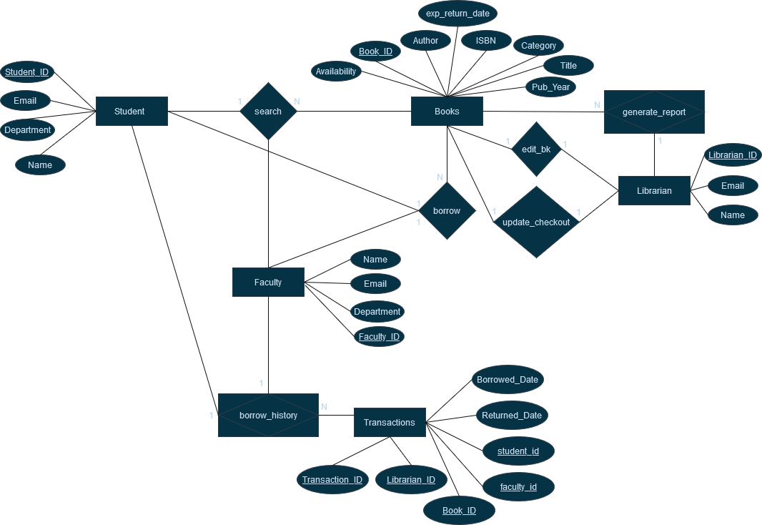

Slide 8
Technical Details
Database Design
Entity-Relationship Model
Database Schema
Underlying DBMS is SQLite (familiar).
Guide the structure of our database.
The meat and bones of our database.

Slide 9
Data Schema (1) - Books
Attribute Name | Data Type | Brief Description
Book_ID | Primary key, char(9), not null | Unique identification number for books
Title | char(255) | A book’s title
Author(s) | char(255) | A book’s authors
Pub_year | Integer | A book’s publication year
ISBN | varchar(13), UNIQUE | A book’s International Standard Book Number (ISBN)
Category | char(255) | A book’s literary category
Availability | BOOLEAN | A book’s availability status
Exp_Return_Date | DATE | The expected return date of a book

Slide 10
Data Schema (2) - Students
Attribute Name | Data Type | Brief Description
Student_ID | Primary key, char(9), not null | A unique identification number for students
Email | varchar(255) | An assigned email address for a student (CONSIDER: Constraints)
Department | varchar(100) | A student’s academic department
Name | varchar(100) | A student’s full name (first, middle, and last).

Slide 11
Data Schema (3) - Faculty
Attribute Name | Data Type | Brief Description
Faculty_ID | Primary key, char(9), not null | A unique identification number for faculty members
Email | varchar(255) | An assigned email address for a faculty member (CONSIDER: Constraints)
Department | varchar(100) | A faculty member’s academic department
Name | varchar(100) | A faculty member’s full name (first, middle, and last)

Slide 12
Data Schema (4) - Librarians
Attribute Name | Data Type | Brief Description
Librarian_ID | Primary key, char(9), not null | A unique identification number for librarian
Email | varchar(255) | An assigned email address for a librarian (CONSIDER: Constraints)
Name | varchar(100) | A librarian’s full name (first, middle, and last)

Slide 13
Data Schema (5) - Transactions
Attribute Name | Data Type | Brief Description
Transaction_ID | Primary key, char(9), not null | A unique identification for each transaction
Librarian_ID | Foreign key, char(9), not null | A unique identification number for librarian
Student_ID | Foreign key, char(9), can be null | A unique identification number for students
Faculty_ID | Foreign key, char(9), can be null | A unique identification number for faculty members
Book_ID | Foreign key, char(9), not null | A unique identification number for books
Returned_Date | Date, can be null | CONSIDER: Constraints. The date that a loaned book was returned
Borrowed_Date | Date, can not be null | CONSIDER: Constraints. The date that a loan book was taken out

Slide 14
Technical Details
Database Design
Entity-Relationship Model
Database Schema
Web Application
Underlying DBMS is SQLite (familiar).
Guide the structure of our database.
The meat and bones of our database.
Built with HTML, JavaScript, Node.js, and Sqlite3

Slide 15
Notable SQL Queries
Add a new book
Borrow a book
INSERT INTO books (title, author, isbn, pub_year, category, availability, exp_return_date)
VALUES ('title_value', 'author_value', 'isbn_value', 'pub_year_value', 'category_value', 'availability_value', NULL);
await db.run('INSERT INTO books (book_id, title, author, isbn, pub_year, category, availability, exp_return_date) VALUES (?, ?, ?, ?, ?, ?, ?, ?)', [isbn, title, author, isbn, pub_year, category, availability, null]);
INSERT INTO transactions (book_id, librarian_id, checkout_date, student_id)
VALUES (?, ?, ?, ?)
await db.run("INSERT INTO transactions (book_id, librarian_id, checkout_date, student_id) VALUES (?, ?, ?, ?)", [bookIsbn, librarianId, checkoutDate, studentId]);

Slide 16
Notable SQL Queries
Get all the books a student borrowed
Get all borrowed books per genre
db = await openDb();
const query = `
SELECT books.title, books.author, transactions.book_id, transactions.checkout_date
FROM transactions
INNER JOIN books ON transactions.book_id = books.isbn
WHERE transactions.student_id = ? AND transactions.checkin_date IS NULL`;
const borrowedBooks = await db.all(query, [studentId]);
db = await openDb();
const query = `
SELECT books.category, COUNT(*) as count
FROM transactions
INNER JOIN books ON transactions.book_id = books.isbn
GROUP BY books.category`;
const borrowedBooksPerGenre = await
db.all(query);

Slide 17
Notable SQL Queries
Search for a book
const conditions = [];
const params = [];
if (author) {
conditions.push("author LIKE ?");
params.push('%' + author + '%');
}
if (isbn) {
conditions.push("isbn = ?");
params.push(isbn);
}
if (category) {
conditions.push("category LIKE ?");
params.push('%' + category + '%');
}
if (title) {
conditions.push("title LIKE ?");
params.push('%' + title + '%');
}
const queryString = `SELECT * FROM books WHERE ${conditions.join(' AND ')}`;
console.log("Executing query:", queryString, params); // Log the final query
SELECT * FROM books WHERE author LIKE ? AND category LIKE ?

Slide 18
DEMO

Slide 19





Key Findings & Insights
Challenges
Creating an ER diagram that captures all desired database functionalities and relationships.
Deciding on an efficient data schema (good data types, constraints, keys).
Freshening up on old skills such as JavaScript and Node.js to build both a front-end and backend all in the same language.
Authentification
Sqlite3 (Node.js module) to interact with our Sqlite database.

Slide 20
Conclusion

Slide 21
Resources
Node.js (link)
Sqlite3 Documentation (link)
SQLite (link)

